Slide 1
Practical:3
Measures of Central Tendency

Slide 2
Data Entry in MATLAB
Example 1:
Find the arithmetic mean and median of the number 6, 7, 10, 11 and 8
Arithmetic Mean:
Command: Mean (x)

Slide 3
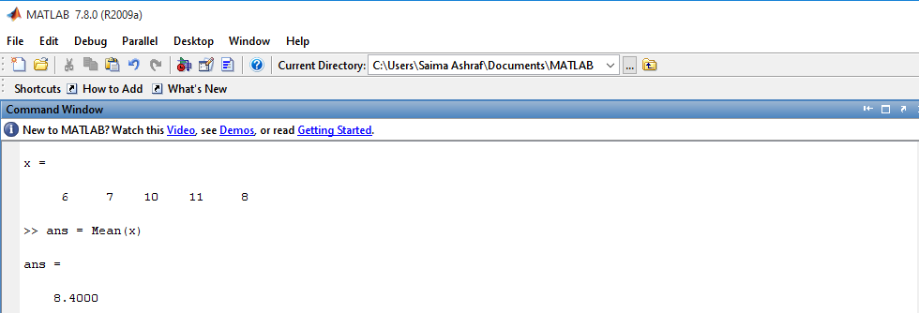
Arithmetic Mean for Ungrouped Data

Slide 4
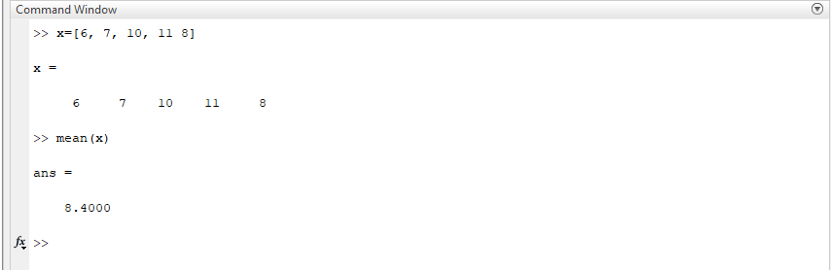
M Amas Waseem

Slide 5
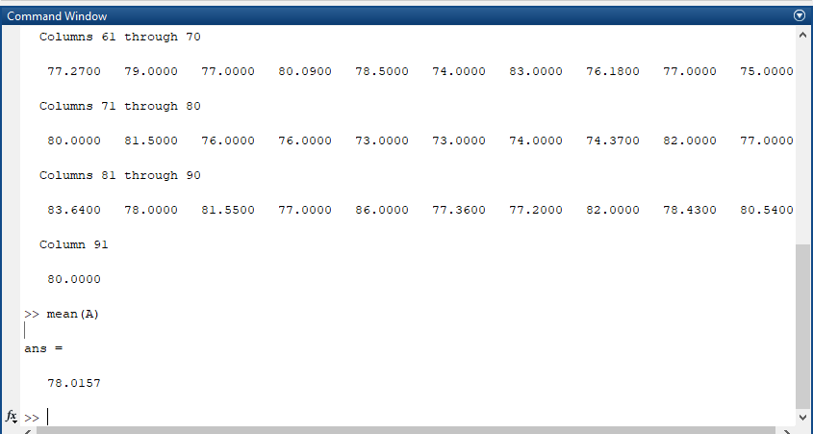
Amas Waseem

Slide 6
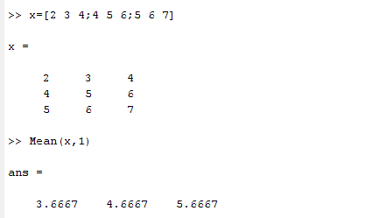
Arithmetic Mean
Mean each column:
Command: Mean (x, 1)

Slide 7
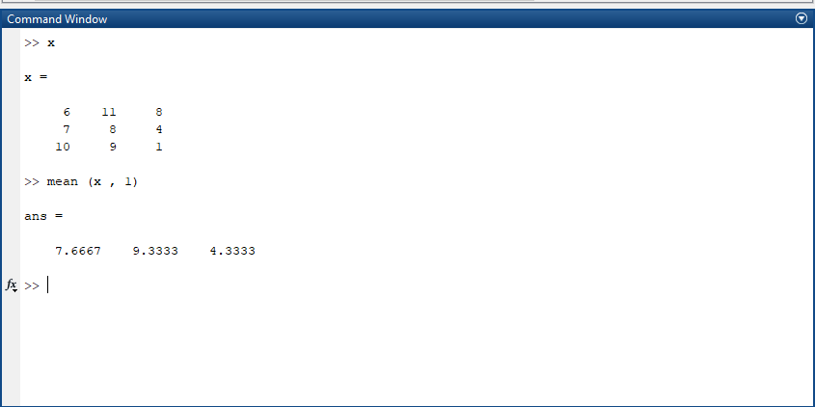
M Amas Waseem

Slide 8
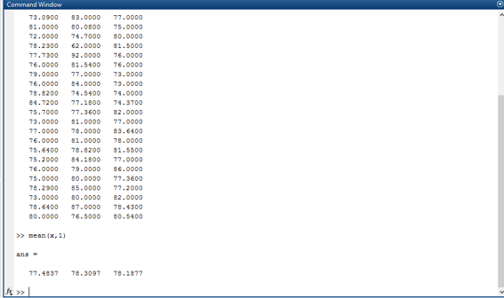
Amas Waseem

Slide 9
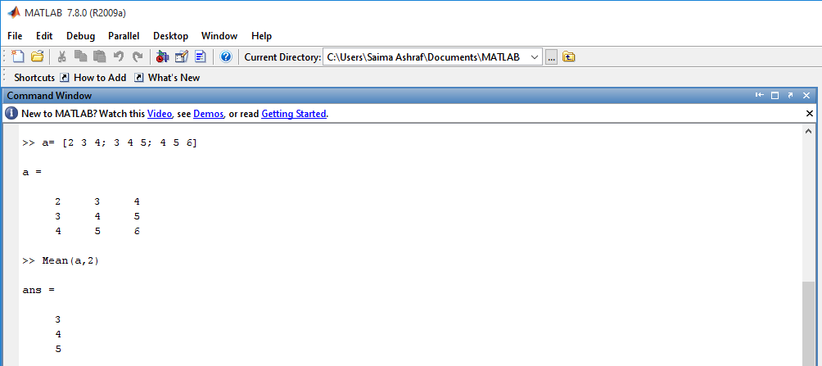
Arithmetic Mean
Mean each row:
Command: Mean (a, 2)

Slide 10
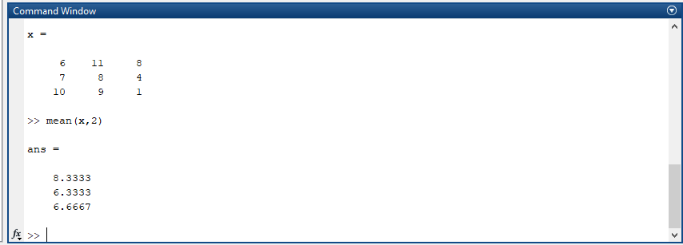
M Amas Waseem

Slide 11
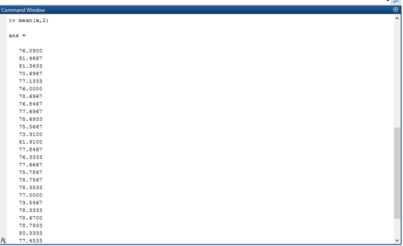
Amas Waseem

Slide 12
Exercise Question
Find the arithmetic mean and median of the following numbers using MATLAB built-in function.
2, 4, 13, 12, 3, 4, 5 ,2 and 8

Slide 13

M Amas Waseem

Slide 14
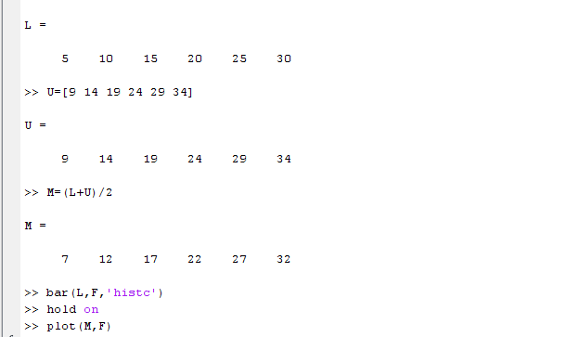
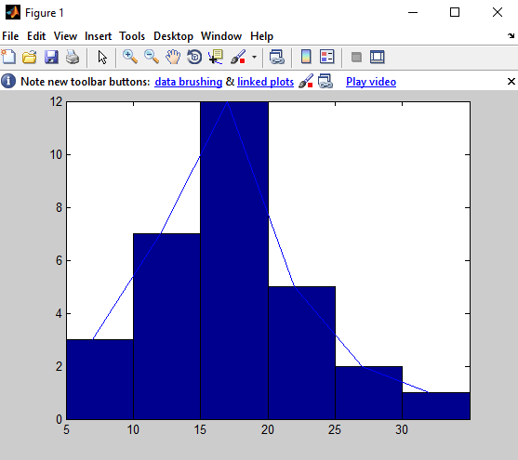
Draw a histogram and frequency polygon on same graph

Slide 15
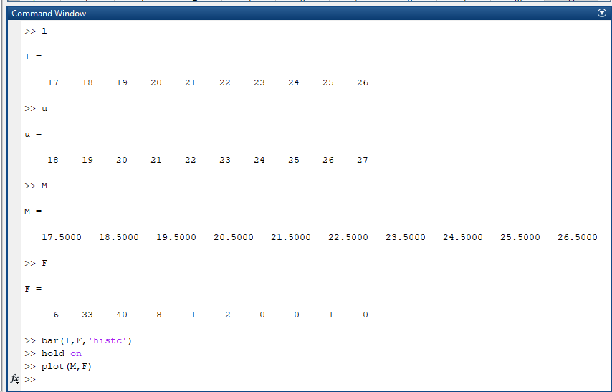
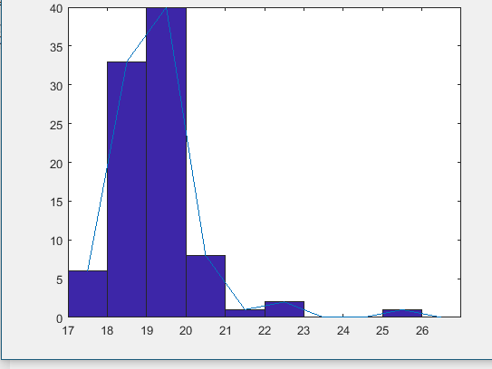
M Amas Waseem

Slide 16
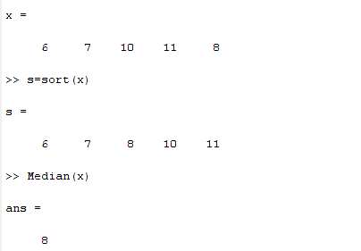
Median
Median:
Command: Median (x)

Slide 17
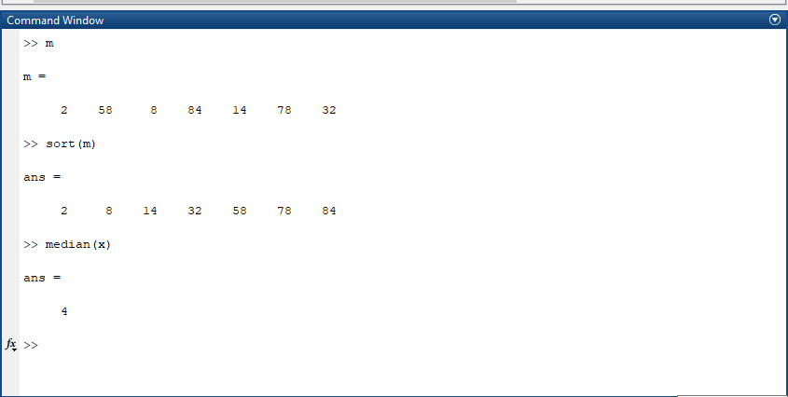
M Amas Waseem

Slide 18
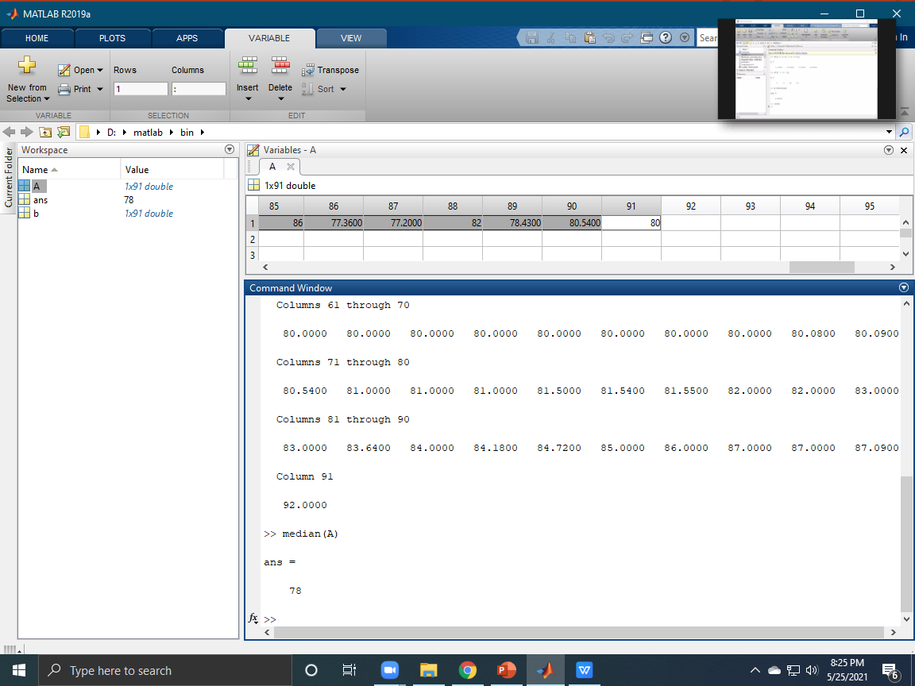
Amas Waseem

Slide 19
Median
Example: 2 (even number of score)
Suppose we have the data below(10 scores)
65 ,55,89, 56, 35 ,14 ,56, 55, 87, 45
we ﬁrst need to rearrange that data into order of magnitude (smallest ﬁrst)
Only now we have to take the 5th and 6th score in our data set and average them to get a
Median of 55.5

Slide 20
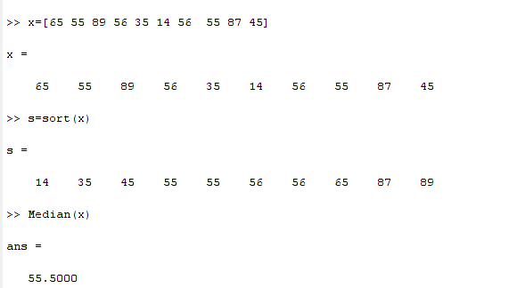
Median

Slide 21
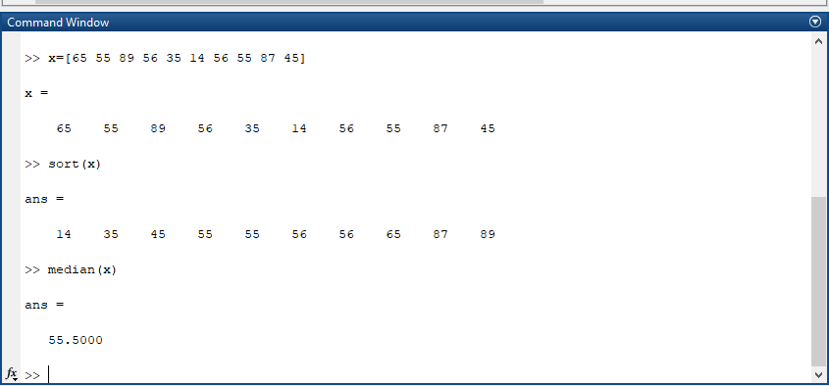
M Amas Waseem

Slide 22
Mode
Example 3:
For the data given below, find Mode
12, 13 14,11,15,16,11,9,56,44,11

Slide 23
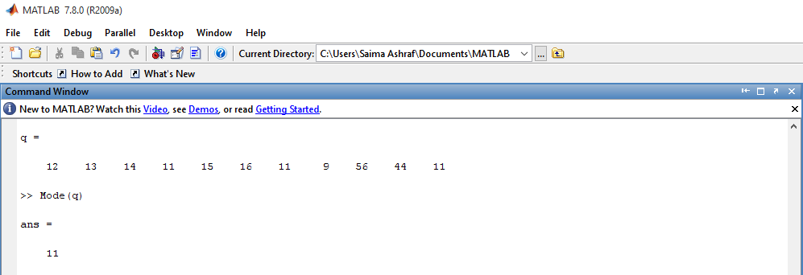
Mode
Command: Mode (q)

Slide 24
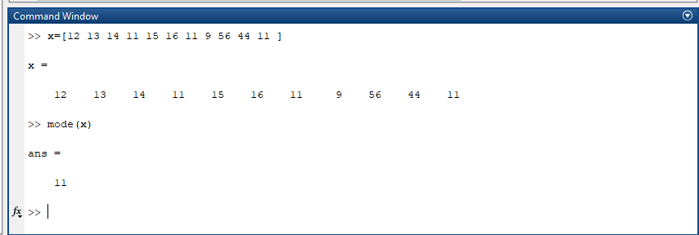
M Amas Waseem

Slide 25
Amas Waseem

Slide 26
Exercise Question
Find the Mode of the following numbers using MATLAB built-in function.
2, 4, 13, 12,12,13, 4,12, 5 ,2 and 8

Slide 27
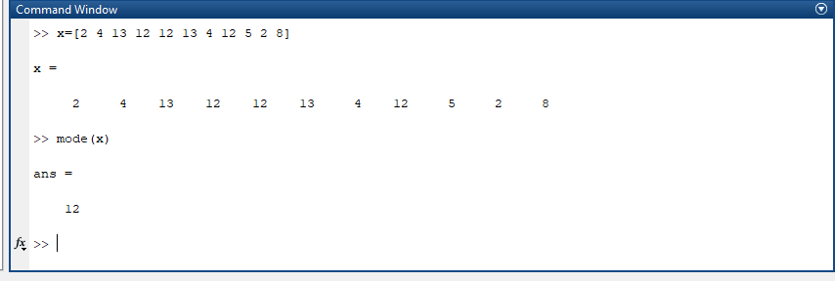
M Amas Waseem

Slide 28
Weighted Mean
Example 4:
Compute the weighted mean of the price of wheat for the following data assuming the quantities consumed as weight.
Price | 5.50 | 6.00 | 7.00 | 8.00
Qty.Consumed(kg) | 4 | 6 | 18 | 10

Slide 29
Step’s
>> x=[5.50 6.00 7.00 8.00]
>> w=[4 6 18 10]
>> sum_w=sum(w)
>> wx= w.*x
>> sum_wx=sum(wx)
>> mean=sum_wx/sum_w

Slide 30
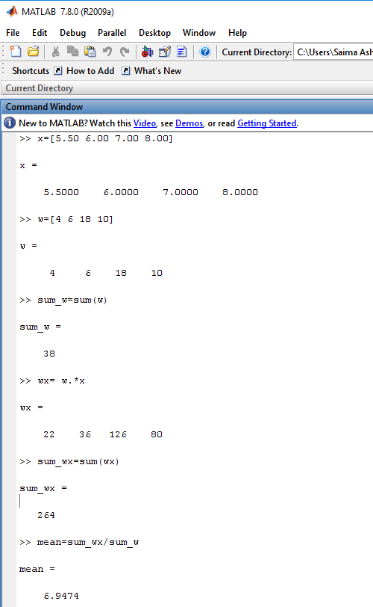
Weighted Mean

Slide 31
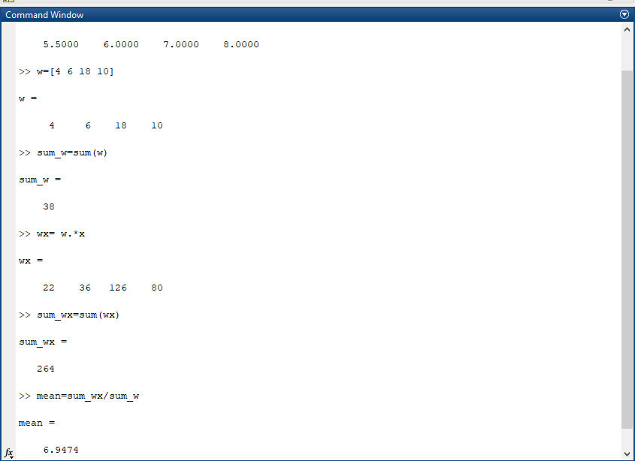
M Amas Waseem

Slide 32
Assignment Question: NOTE: Work in MATLAB
Question: 1
Find the Arithmetic mean of the numbers 3, 56 ,12,32,34,23,1,2,5,7,34,56,23,13,45,56,34,67,56,78.

Slide 33
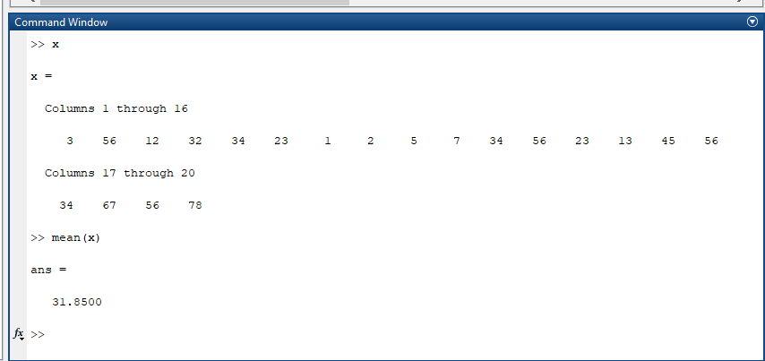
M Amas Waseem

Slide 34
Assignment Question(J)
Question: 3
A person walks 9 hours at a speed of 3 km.p.h,again walks 8 hours at a speed of 4 km.p.h.Find the average speed.
Formula:
Average speed= Total speed/Total Time.

Slide 35
Assignment Question(J):
Question: 4
The following data shows the results of a survey which was conducted to find out the colour preference of people regarding the cars.
Orange Orange White Grey Black Orange White Orange White Grey Black Orange Orange Grey Orange Black Orange White Black Black
Find the Modal colour for the above qualitative data.

